Slide 1


RecyclerView
By Nikolas petrou

Slide 2
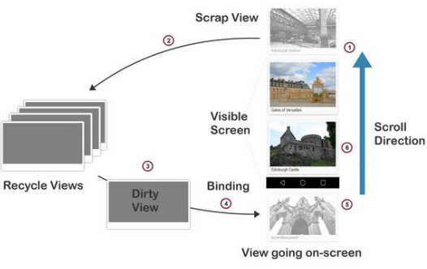
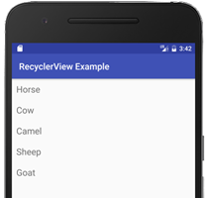
What is a RecyclerView?
Appeared in Android 5.0 (API 21)
UI element that presents sub-elements of a scrolling list
Replacement of ListView and GridView (Legacy Elements)
Faster for many elements-objects
More efficient - dynamically creates the elements (“recycles Views”)
More infographic resources, whose size and color can be edited.

Slide 3
01.
02.
Gradle Dependency
LayoutManager
03.
04.
Adapter
Data of the list
What do I need for a RecyclerView
RecyclerView was an independent library in previews versions
Arranges the individual elements in your list (mostly used: Linear or Grid
Connects the data to the RecyclerView. Use of ViewHolder class for Views that make up an object to appearance in the list

Slide 4
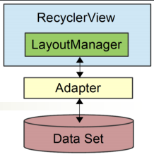
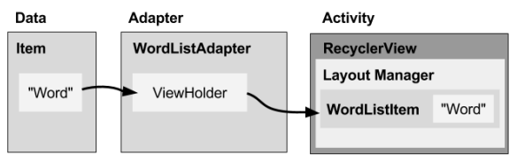
01
What do I need for a RecyclerView
Venus has a beautiful name and is the second planet from the Sun. It’s terribly hot

Slide 5
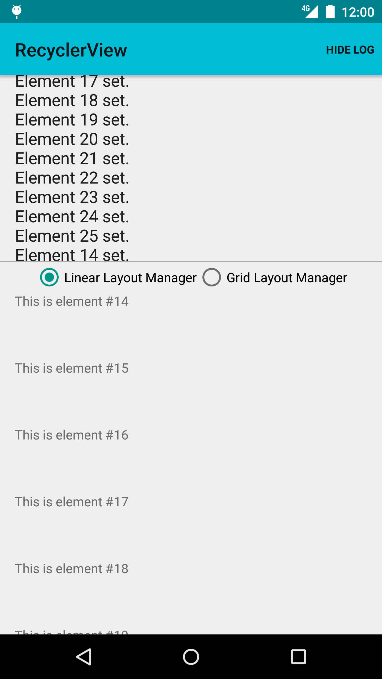
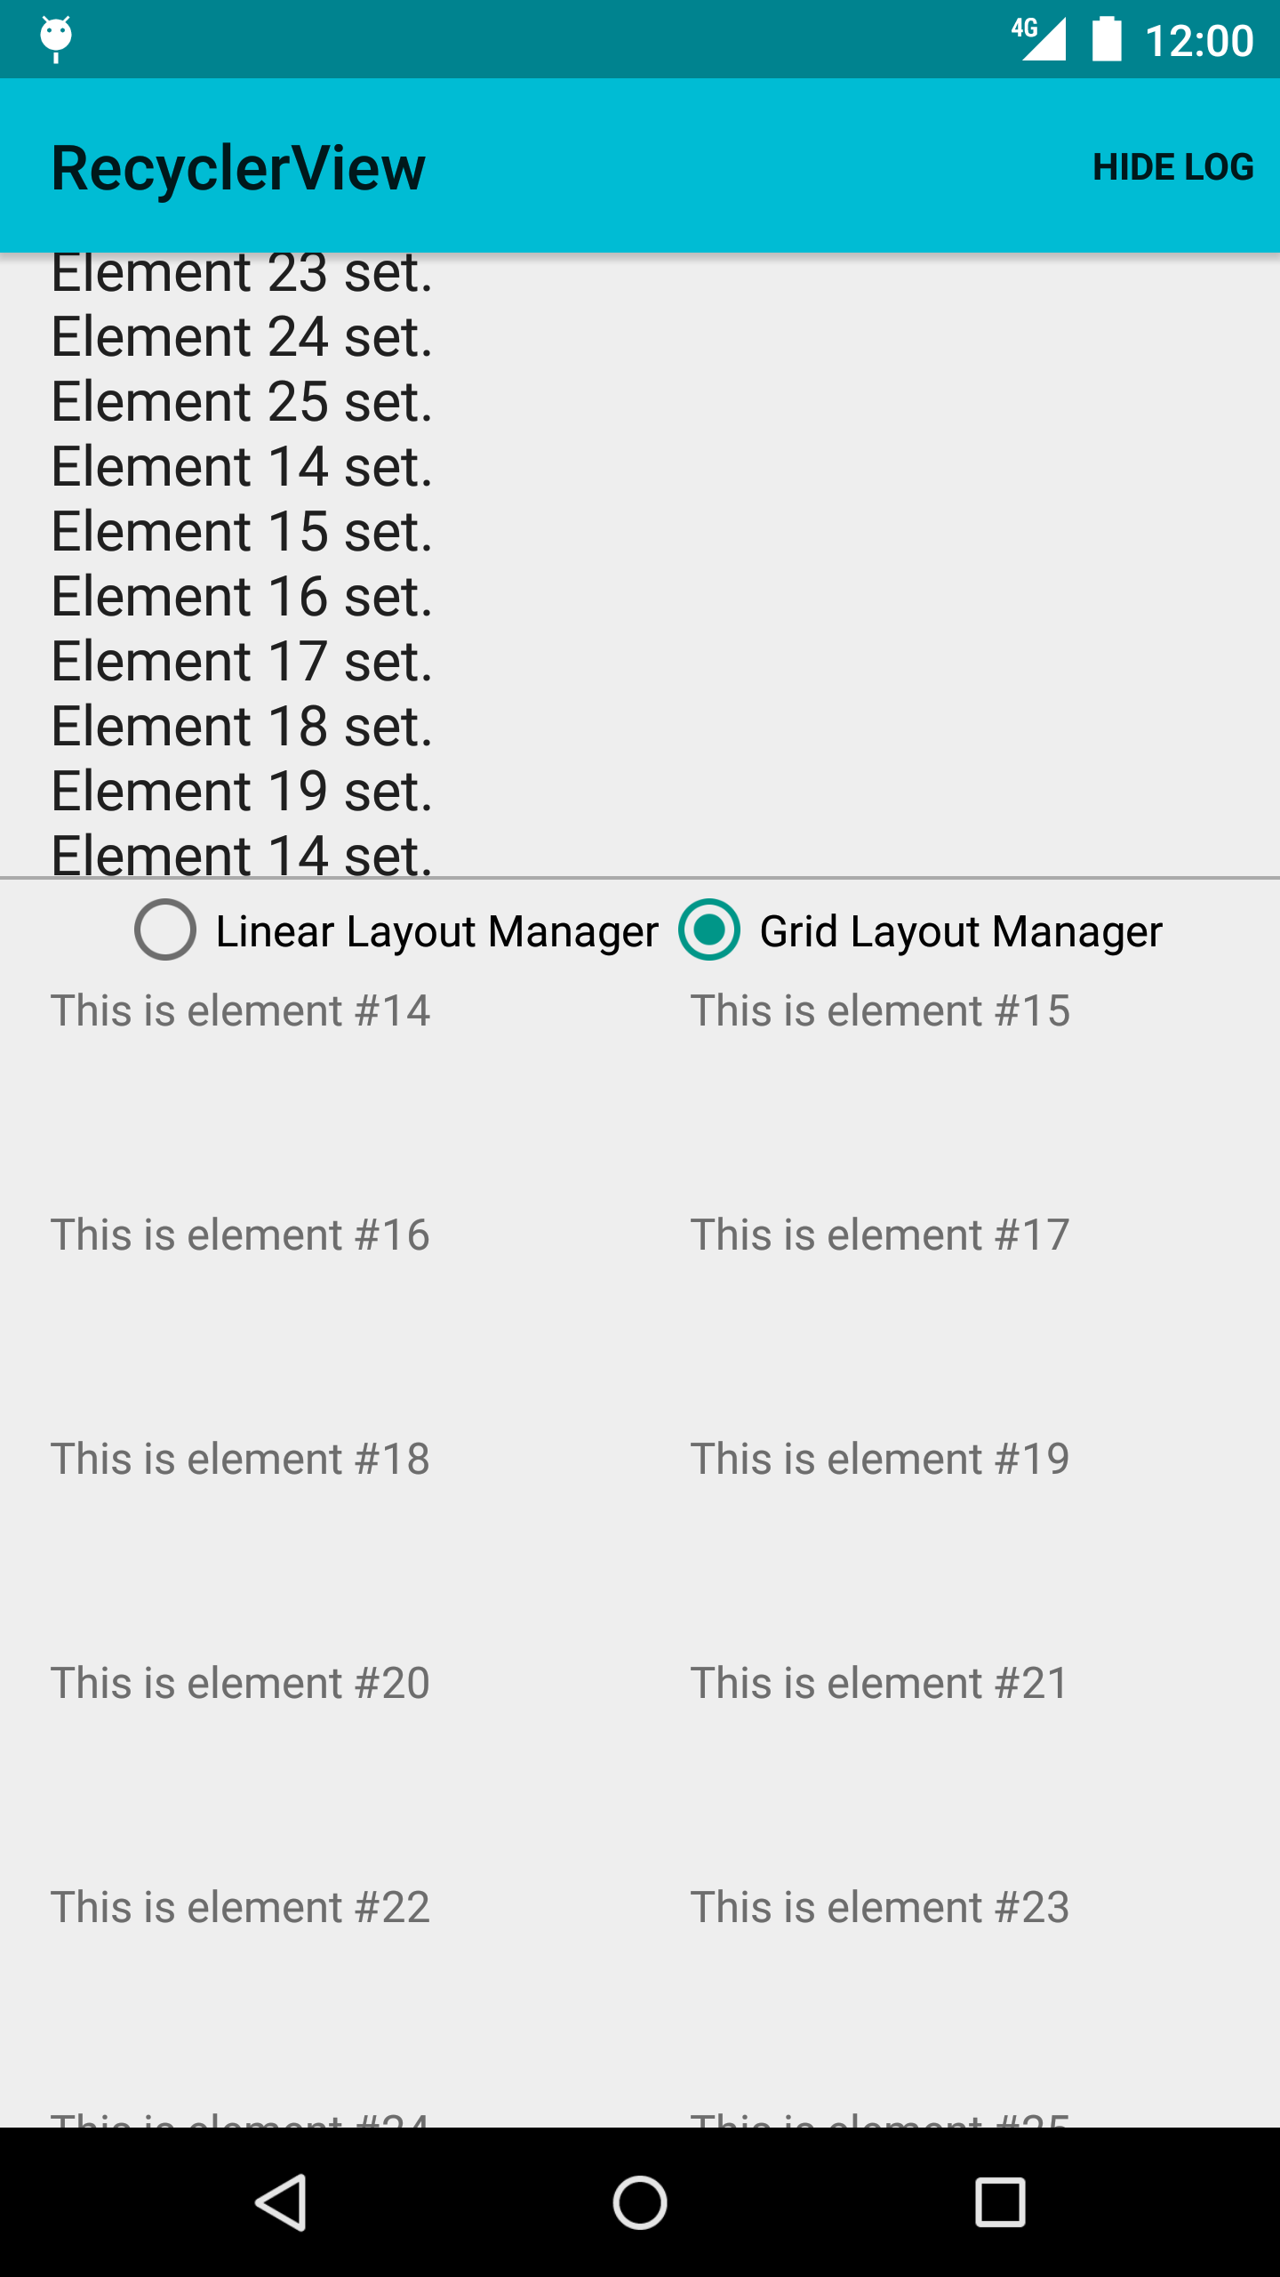
LayoutManager for RecyclerView:
Orientation of the List
Manages positions of the items
Defines type of list (i.e List, Gird)
Calculates position and size of items of individual items in the RecyclerView.

Slide 6
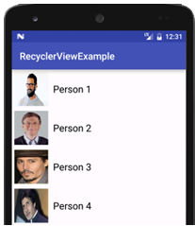
LayoutManager for RecyclerView: LinearLayoutManager
Vertical Orientation (Default):
https://abhiandroid.com/materialdesign/recyclerview-as-listview.html

Slide 7
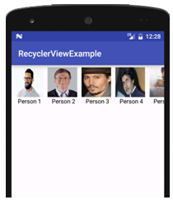
LayoutManager for RecyclerView: LinearLayoutManager
Horizontal Orientation:
https://abhiandroid.com/materialdesign/recyclerview-as-listview.html

Slide 8
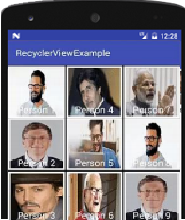
LayoutManager for RecyclerView: GridLayoutManager
Horizontal Orientation:
https://abhiandroid.com/materialdesign/recyclerview-gridview.html

Slide 9
Adapter for RecyclerView
Another Class
Extends RecyclerView.Adapter class
The instance of the Adapter is connected to the RecyclerView with the method setAdapter()
Overrides three key methods
onCreateViewHolder(): Creates and returns ViewHolder object
onBindViewHolder(): Accepts the ViewHolder object created by onCreateViewHolder(), fills it with the display data
getItemCount(): Returns the number of list elements-objects
Has ViewHolder extends RecyclerView.ViewHolder as nested class
ViewHolder has-includes the Views that represent a list object

Slide 10
Basic Java code for Adapter and ViewHolder
https://developer.android.com/guide/topics/ui/layout/recyclerview#implement-adapter

Slide 11

View Item Layout Definition
The layout for each view item of the ViewHolder is defined in an XML layout file e.g., text_row_item.xml:
https://developer.android.com/guide/topics/ui/layout/recyclerview#implement-adapter

Slide 12

- Jedi Master Yoda
“Use it wisely you must”

Slide 13

THANK YOU

Slide 14

“Too many things, how do I add them all together?”

Slide 15

CODING TIME

